Slide 1
Georgia State University
Department of Computer Science
WEB PROGRAMMING 4370/6370
PROJECT 2-PHP-HTML-CSS
REACH MILESTONE GAME

Slide 2
In a game it’s difficult to know when to stop ~German proverb
Poject by
Annavarapu Maha Lakshmi
Ahmadou Deme

Slide 3
Outline
Star UML diagram
User-Statement of problem
Design overview
Screenshots

Slide 4
Statement
Reach milestone game involves pure luck.
It is a dice game played between two people.
A number of random “danger zones” are pictured on the board, each connecting two specific board squares.

Slide 5
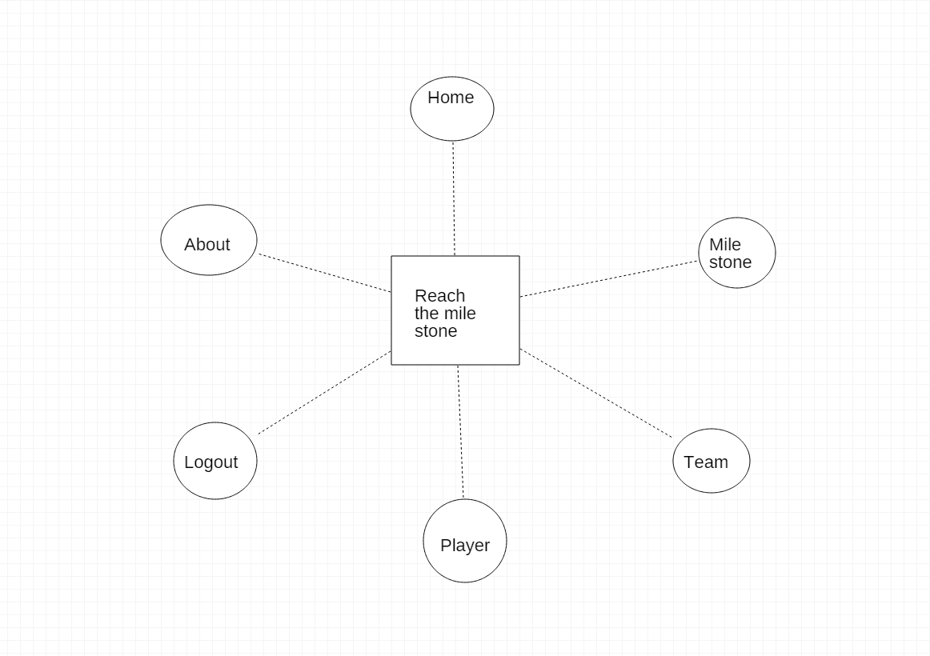
Star UML

Slide 6
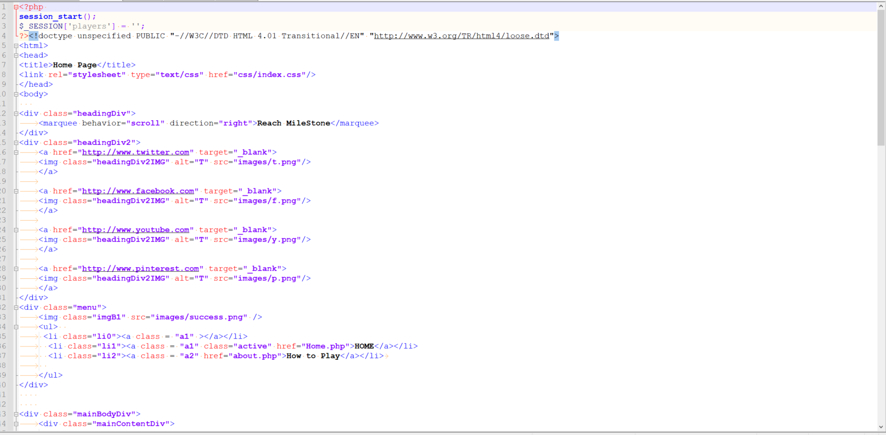
Home

Slide 7
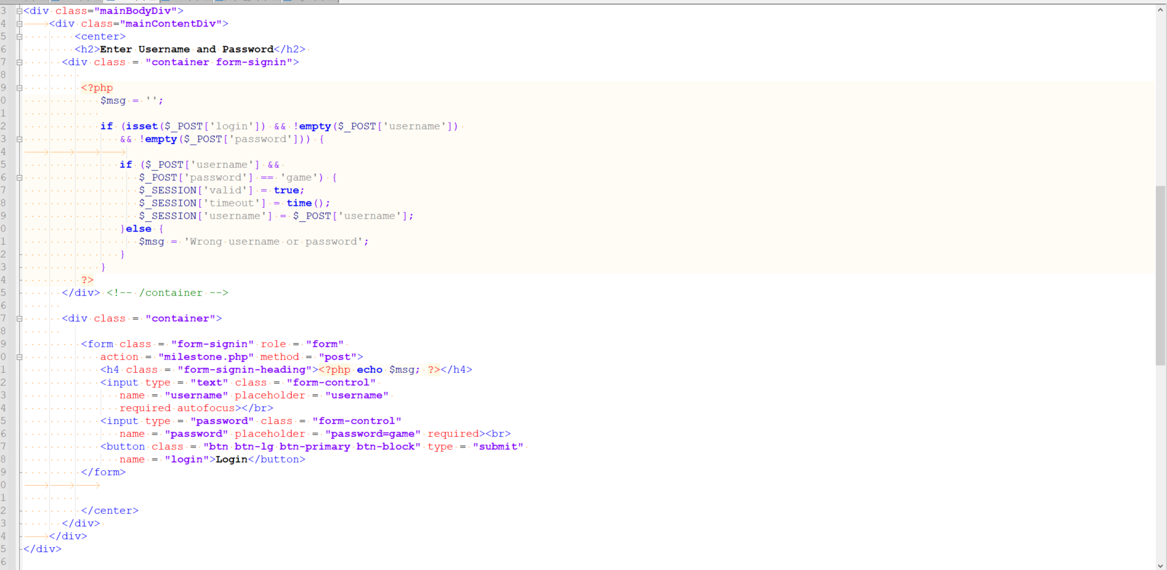

Slide 8
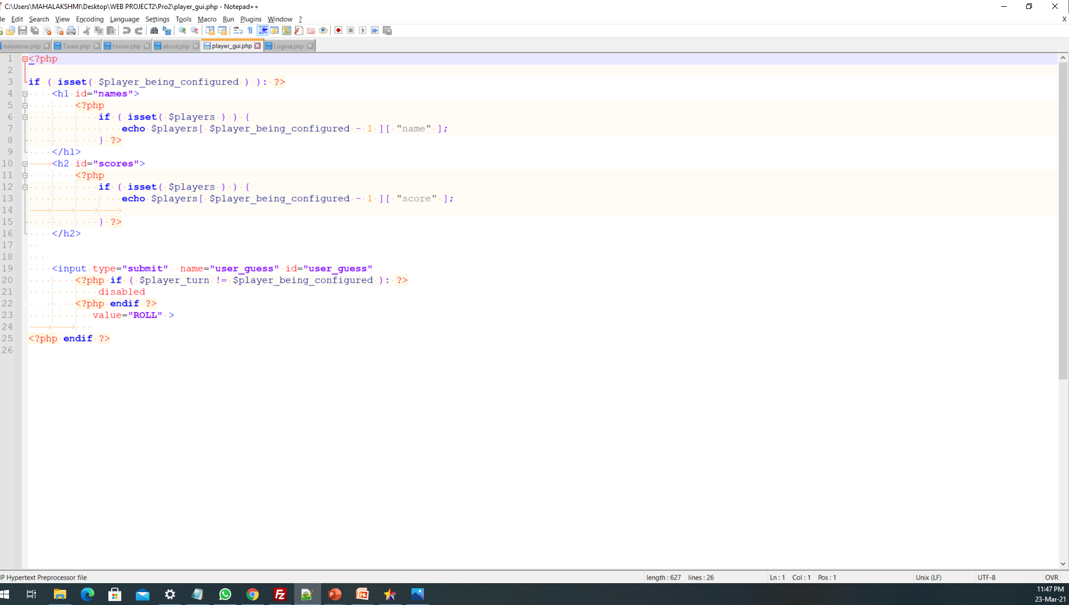
Player

Slide 9
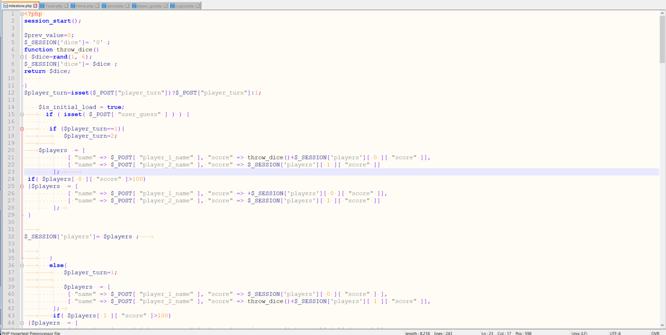
Milestone

Slide 10
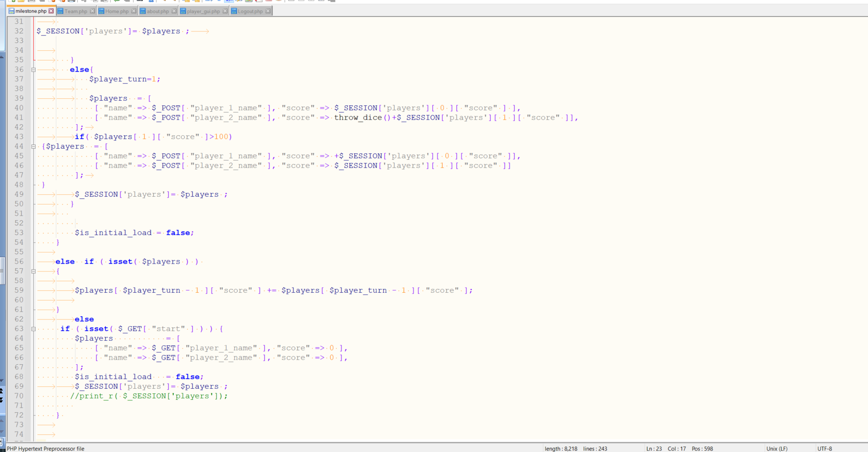
Milestone

Slide 11
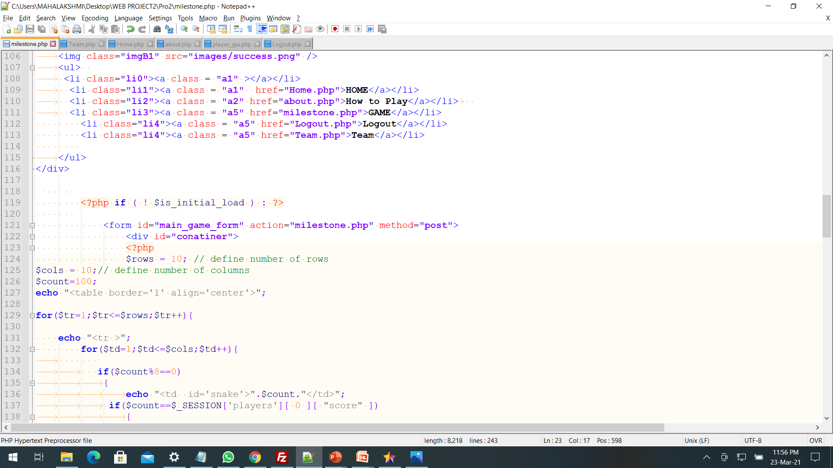

Slide 12
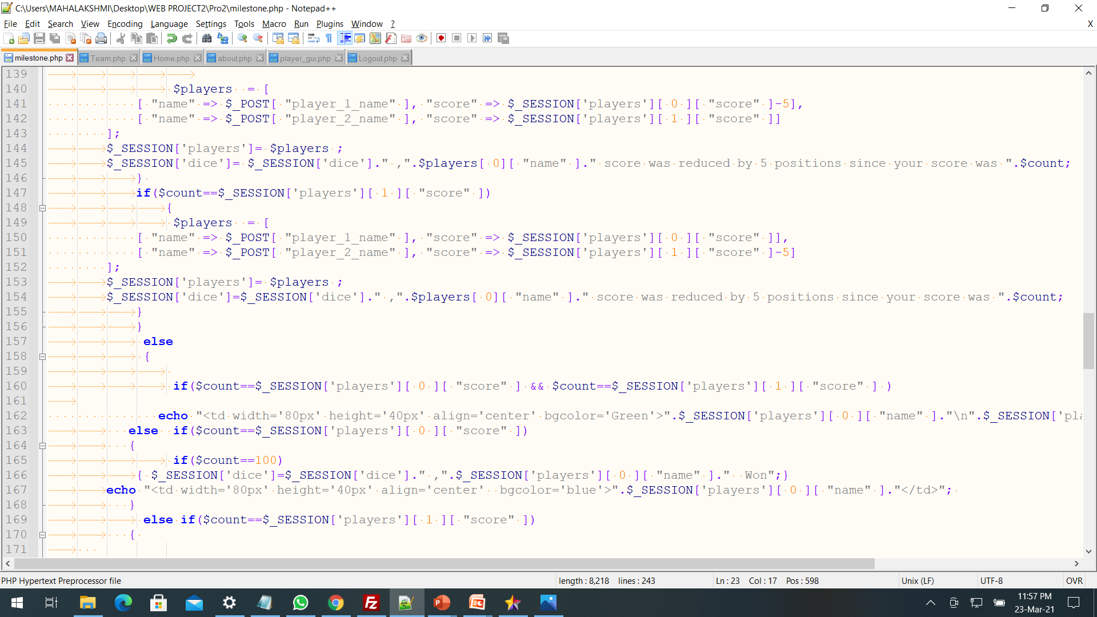

Slide 13
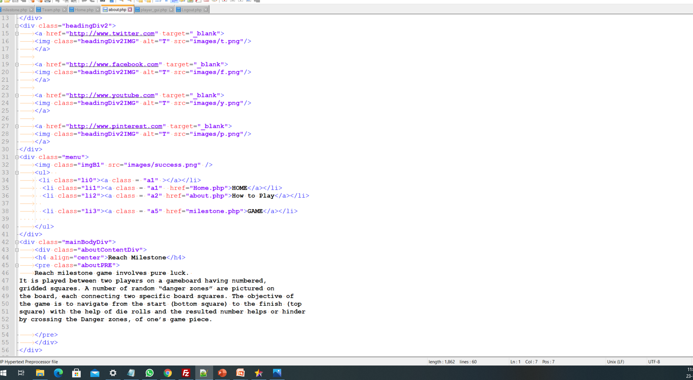
About

Slide 14
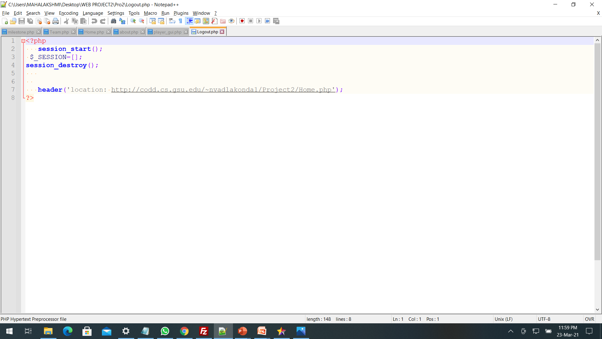
Logout

Slide 15
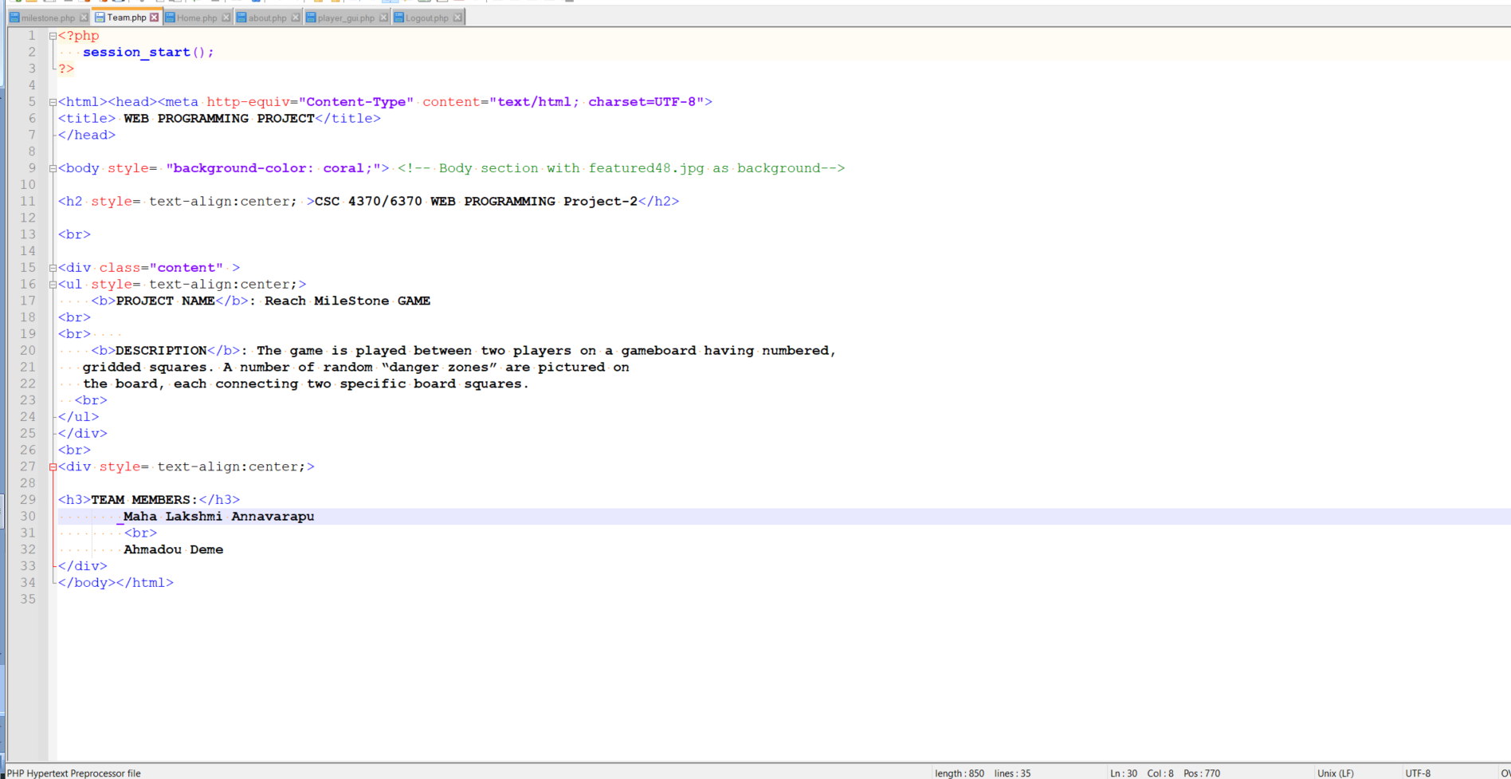
Team

Slide 16
Thank you

